Slide 1
Rec Shokubutsu: A Plant Identification Application
Submitted in the partial fulfillment for the award of the degree of
BACHELOR OF ENGINEERING
IN
Computer Science and Engineering (AIML)
Submitted by:
Neel Madhab Roy (19BCS6064)
Under the Supervision of:
Mr. Ajay Pal
Department of AIT-CSE
DISCOVER . LEARN . EMPOWER

Slide 2
Outline
Introduction to Project
Problem Formulation
Objectives of the work
Methodology used
Results and Outputs
Conclusion
Future Scope
References

Slide 3

Introduction
This project aims at accurate and effective development of an application that helps people to identify plant species using simples plant leaves image without begin concerned about the knowledge of botany (study of plants).
So, identifying the plants correctly is out of reach of an ordinary person as it requires specialized knowledge and only the experts of botanical background are able to pull off this task.
This application will help us to identification of new or rare plant species to improve the balance in the ecosystem.

Slide 4
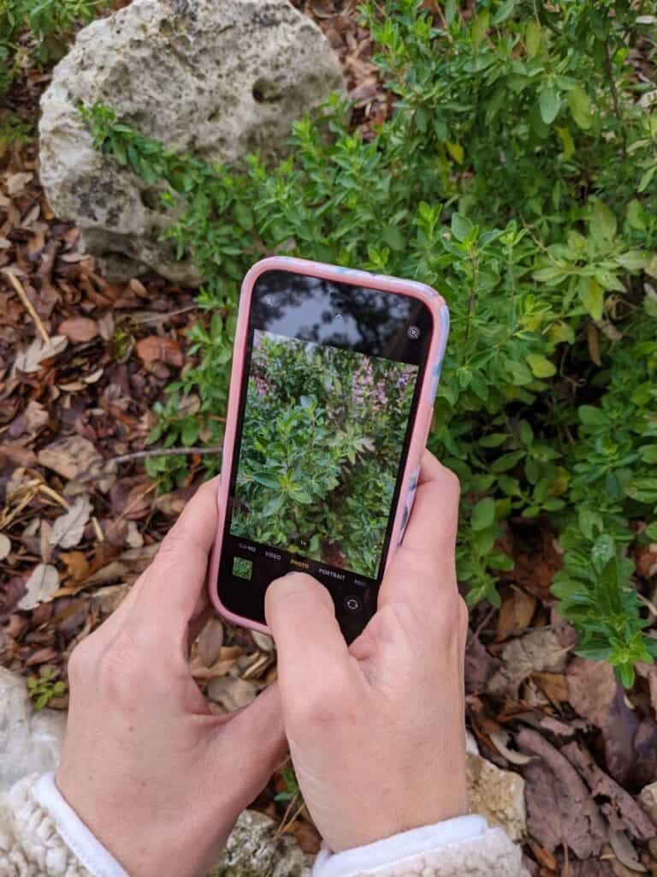
Problem Formulation
Identification of plants by conventional keys is complex, time consuming, and due to the use of specific botanical terms frustrating for non-experts. This creates a hard to overcome hurdle for novices interested in acquiring species knowledge, therefore become not just a long-time desire but a need to better understand, use, and save biodiversity.
Moreover, Plant identification is not exclusively the job of botanists and plant ecologists. It is required or useful for large parts of society, from professionals (such as landscape architects, foresters, farmers, conservationists, and biologists) to the general public (like ecotourists, hikers, and nature lovers).

Slide 5
Objectives of the Work
The purposed work is aimed to carry out work leading to the development of the web application which will have the feature to identify plants based on the leaf image provided by the user.
This project aims at accurate and effective development of an application that helps people to identify plant species using simples plant leaves image without begin concerned about the knowledge of botany (study of plants).
We are going to implement these by building our own CNN model on 184 distinct classes of plant species containing 7744 plant species images. The deep learning model with conventional neural network is going to be implemented using Tensorflow and will be used in the application using an API.

Slide 6

Methodology used
A detailed study and analysis of the leafsnap datasets will be carried out in order to make conventional neural network model.
Pre-processing will be done on datasets: such as image resizing, image rescaling and data augmentation.
A CNN model is implemented with 2 dense layers.
The model is to be trained for 50 epochs with ‘adam’ optimizer and ‘accuracy’ as a metrics.
On achieving the desired results, the visualizations and a comparison between training accuracy with validation accuracy and training loss with validation loss is done.
Used FAST API as a backend for deployment and testing through postman.
The web application is created to access the model and identify the plant through plant leaves.

Slide 7
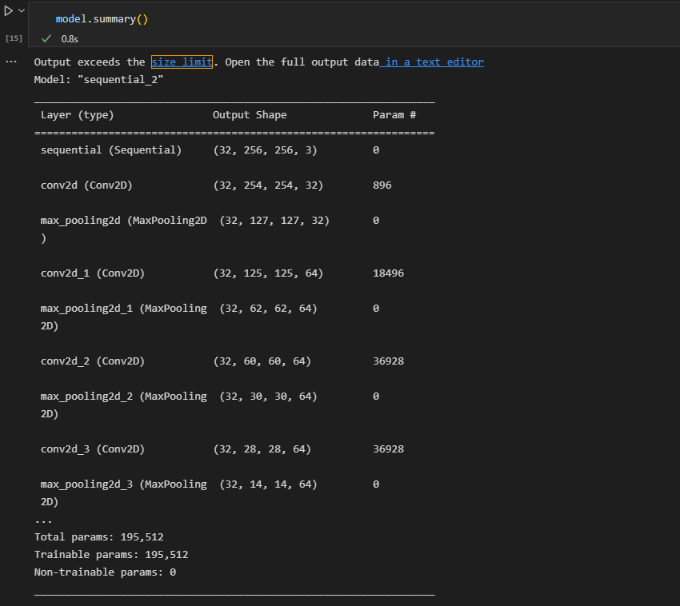
Results and Outputs
Model Summary ->

Slide 8
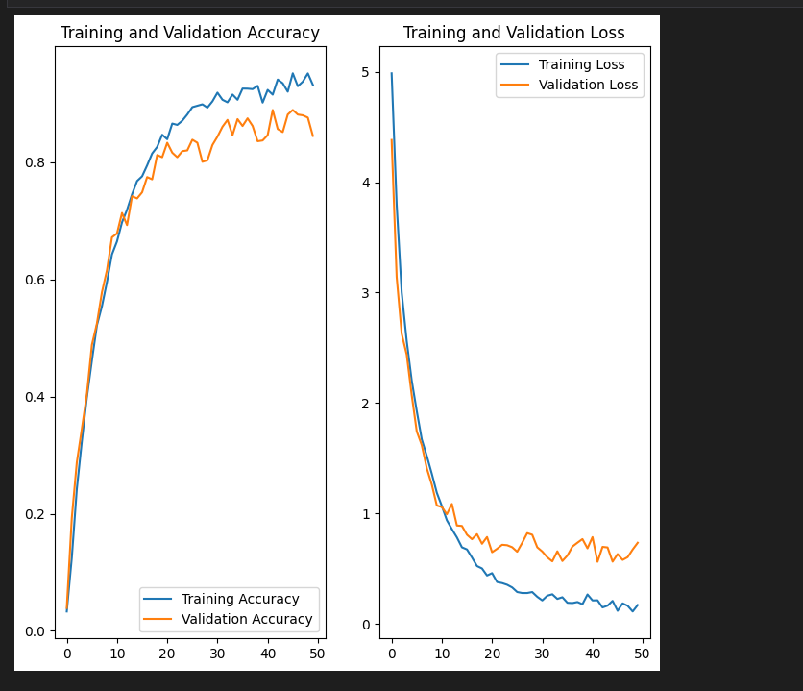
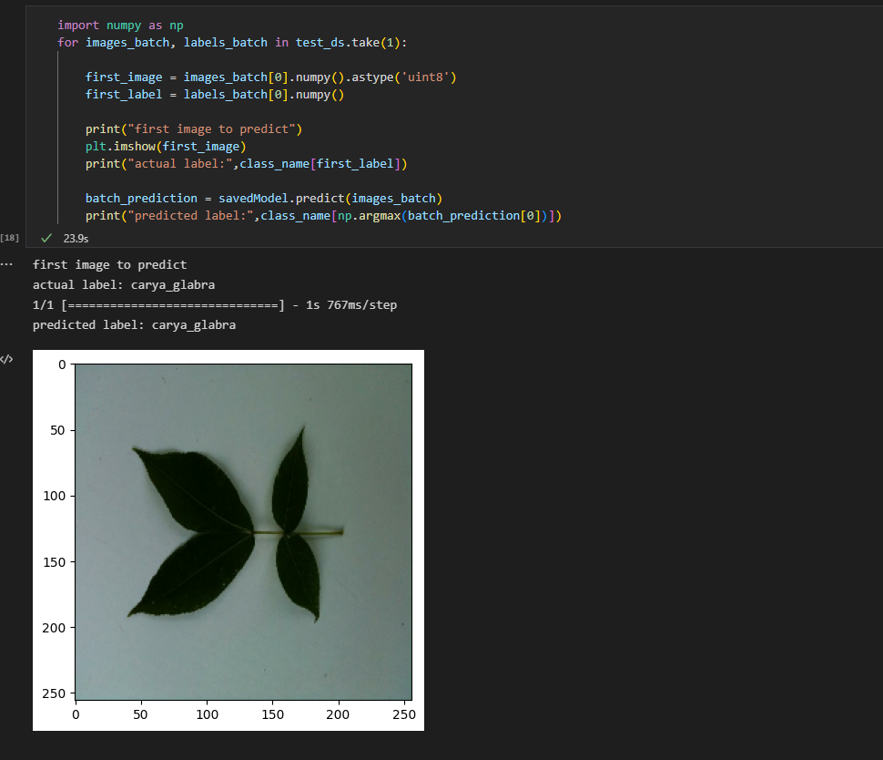

Slide 9
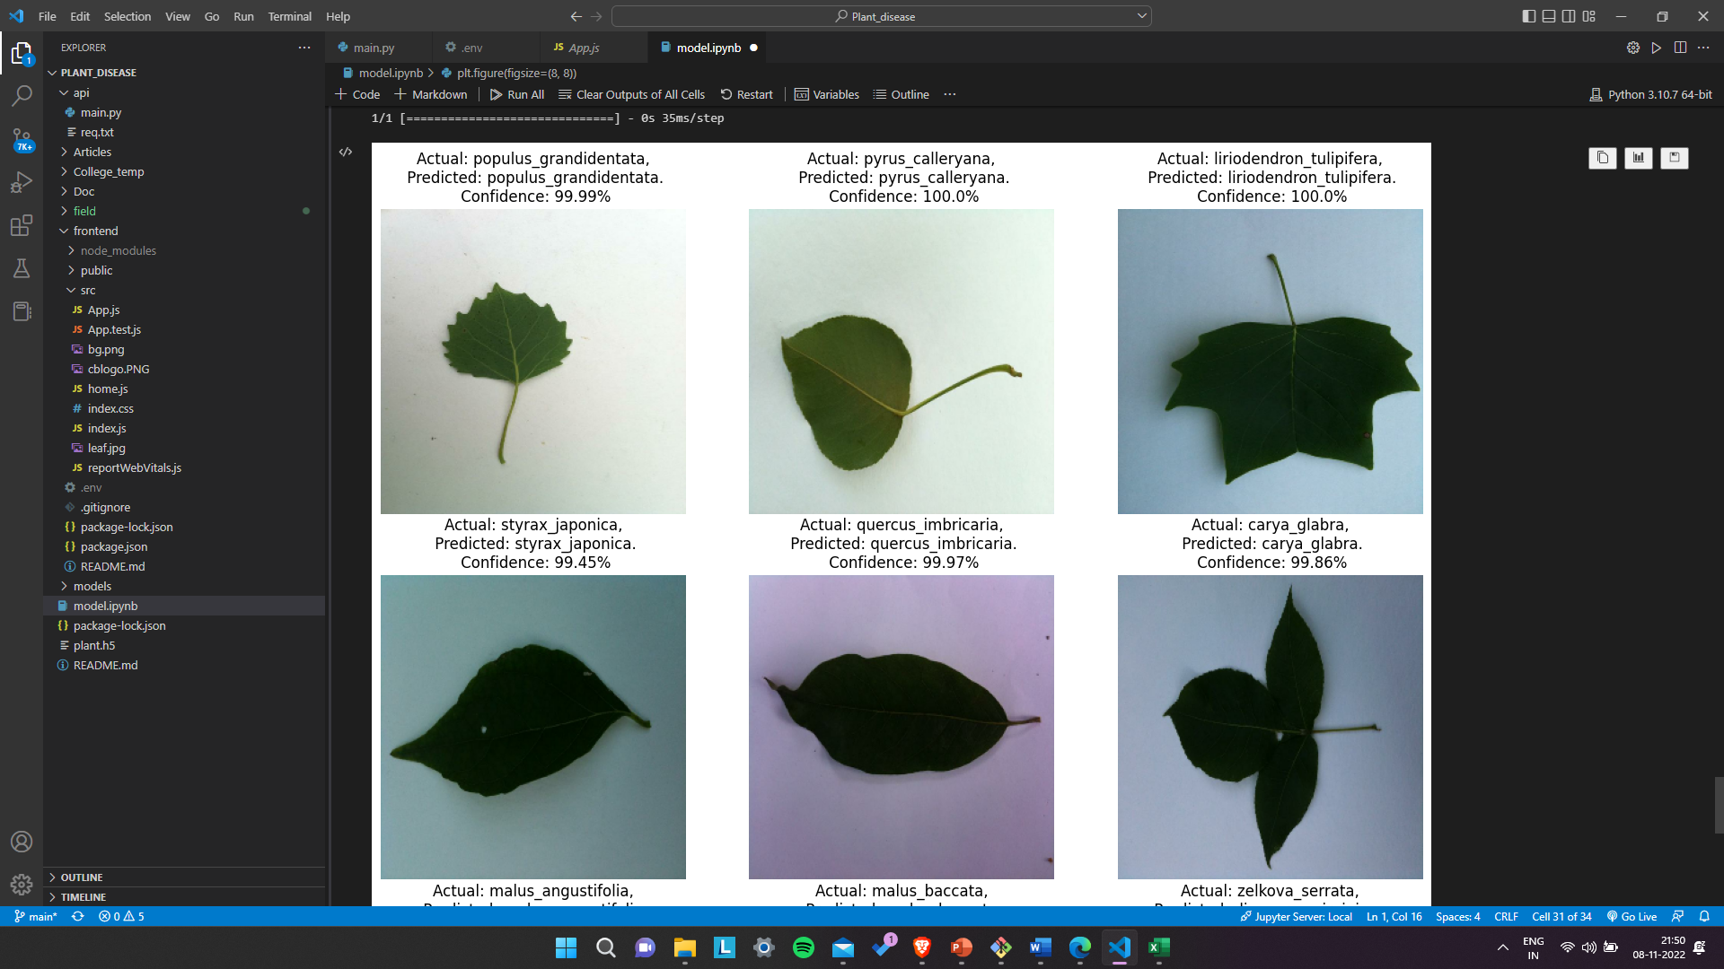

Slide 10
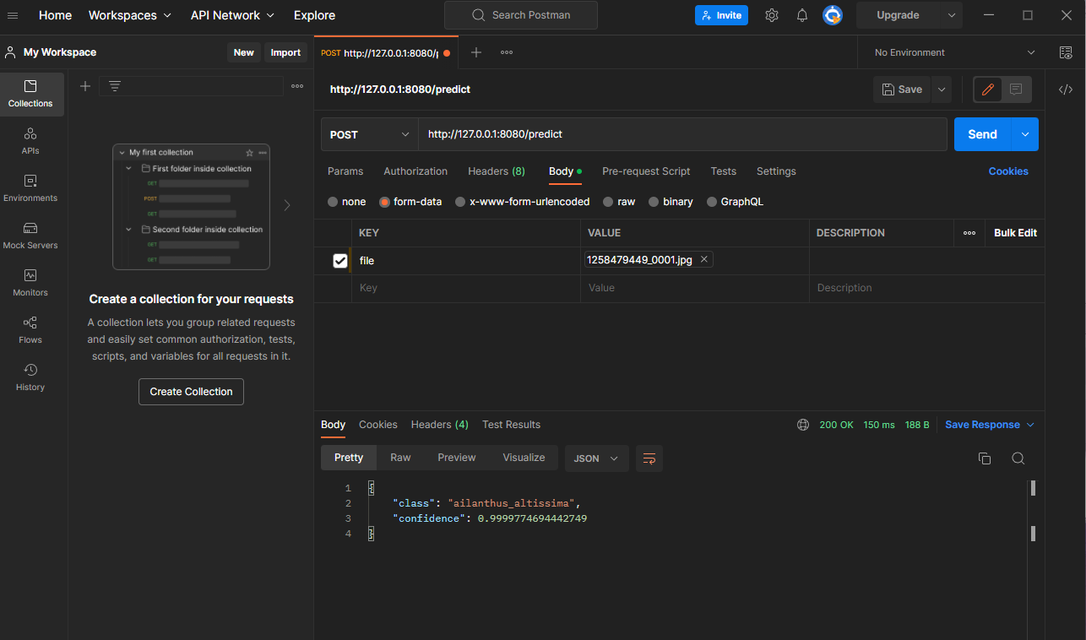

Slide 11
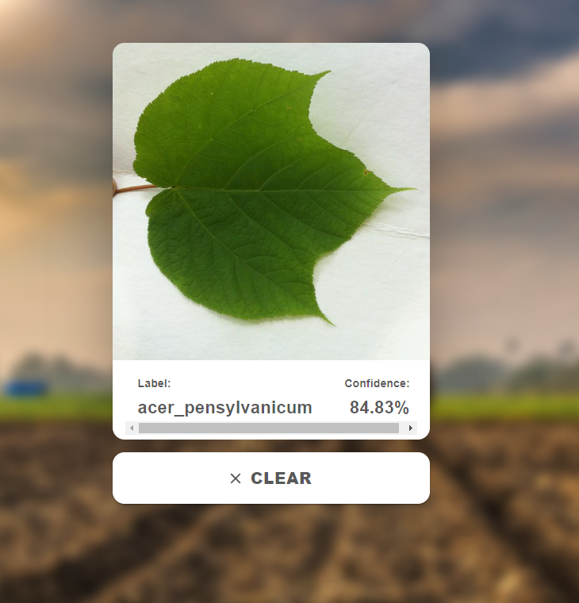
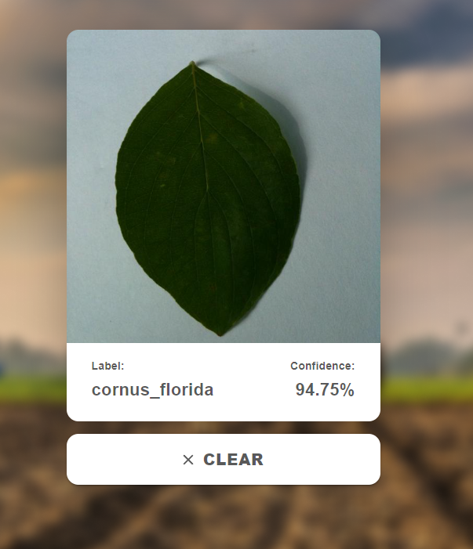

Slide 12
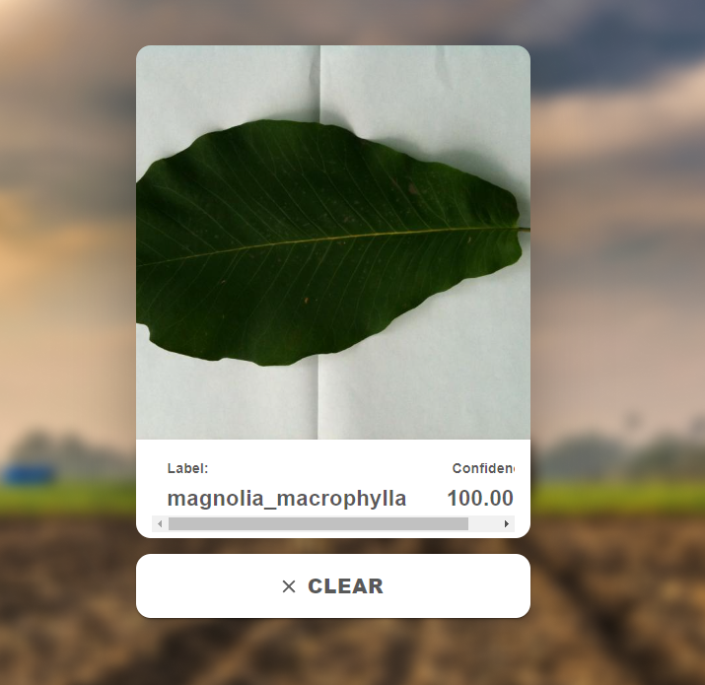
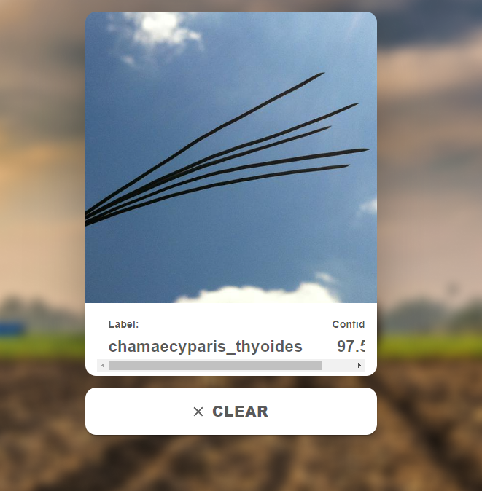

Slide 13
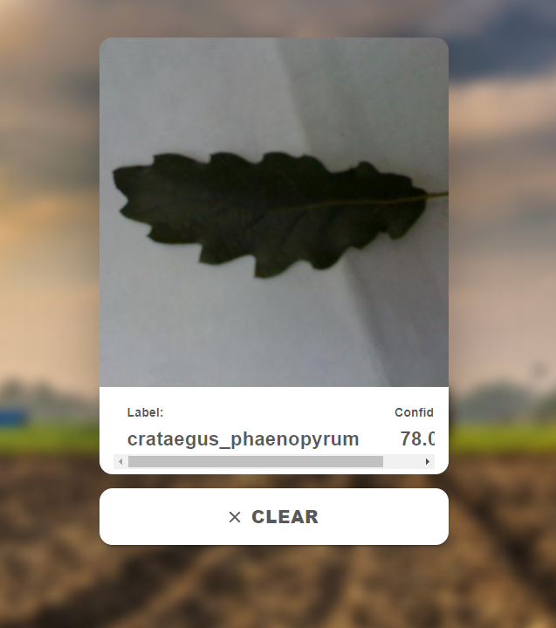
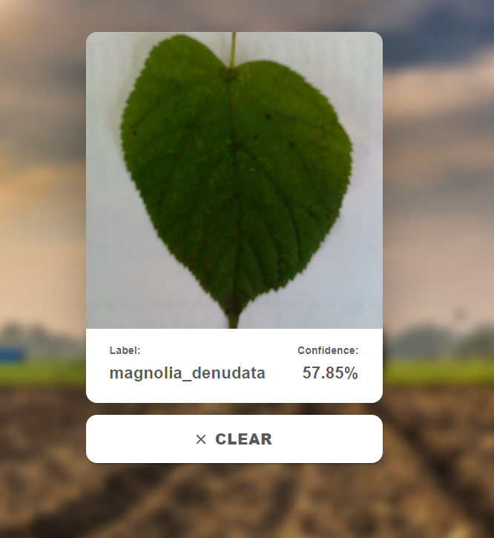

Slide 14
Conclusion
Developed an application that helps people to identify plant species using simples plant leaves image without begin concerned about the knowledge of botany (study of plants).
The Identification performance of the models will be good enough to be used in web application for effective use.
The end result of this project is a web application.

Slide 15
Future Scope
There are enormous plant species in the world, which is nearly 390,000 in numbers, and each year, new species are reported in different parts of the world. Plants are very different from one another hence requiring in depth taxonomic knowledge to identify and assign them to a particular species. Many activities such as studying the flora of a particular area, investigation of the endangered species, discovering new plant species depends profoundly upon precise and accurate dentification skills. With this, the need for automated identification of plant species is increasing. We need more research in this field.

Slide 16
References
Banzi J. & Abayo T. (2021). Plant Species Identification from Leaf Image Using Deep Learning Models. ArXiv, Tranzania Journal of Forestry and Nature Conservation Vol 90.
Sk Hassan, Kumar Maji, Jasinski M., Leonowicz Z. & Jasinska E. (2021). Identification of Plant-Leaf Disease Using CNN and Transfer-Learning Approach. ArXiv, electronics10121388.
Skanda H N, S karanth, Suvijith S, & Swathi K S (2019). Plant Identification Methodologies using Machine Learning Algorithms. ArXiv, ISSN: 2278-0181 Vol 8.
Kaur S. & Kaur P. (2019). Plant Species Identification based on Plant Leaf Using Computer Vision and Machine Learning Techniques. Journal of Multimedia Information System, CC BY-NC 4.0.
Waldchen, J., Rzanny, M., Seeland, M., & Mader P. (2018). Automated Plant species Identification – Trends and future directions. Journal, pcbi, 1005993.
Waldchen J. & Mader P. (2018). Plant Species Identification Using Computer Vision Techniques: A Systematic Literature Review, Archives of Computational Methods in Engineering.

